Slide 1
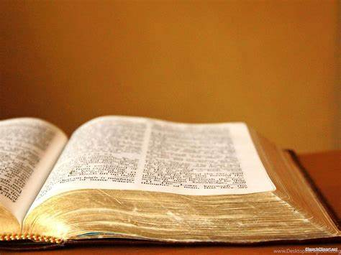
I PROMISE
God’s Great Promises
May 2020 Sermon Series

Slide 2
The Peace God Promise
Lesson One

Slide 3
“I will keep you in perfect peace, whose mind is stayed on Me, because you trust in Me.
Isaiah 26:3 (NKJV)

Slide 4
Deuteronomy 33:24-25 (NKJV)
Scripture Lesson

Slide 5
And of Asher he said: “Asher is most blessed of sons; Let him be favored by his brothers. And let him dip his foot in oil. Your sandals shall be iron and bronze; As your days, so shall your strength be.
Deuteronomy 33:24-25 (NKJV)

Slide 6
The Strength God Promise
Lesson Two

Slide 7
“Asher” means “happy or blessed.”

Slide 8
And Leah’s maid Zilpah bore Jacob a second son. Then Leah said, “I am happy, for the daughters will call me blessed.” So, she called his name Asher.
Genesis 30:12-13 (NKJV)

Slide 9
"Bread from Asher shall be rich, and he shall yield royal dainties.
Genesis 49:20 (NKJV)

Slide 10
Asher’s’ Blessings
Two Key Points:

Slide 11
Your sandals shall be iron and bronze; As your days, so shall your strength be.
Deuteronomy 33:25

Slide 12
1. Suitable Shoes
“shoes will be iron and brass.”
Military Strength

Slide 13
And He said to me, “My grace is sufficient for you, for My strength is made perfect in weakness.” Therefore most gladly I will rather boast in my infirmities, that the power of Christ may rest upon me.
II Corinthians 12:9 (NKJV)

Slide 14
Our footwear will match the road we walk in life.
God has the right shoes for the right road.

Slide 15
And I have led you forty years in the wilderness. Your clothes have not worn out on you, and your sandals have not worn out on your feet.
Deuteronomy 29:5 (NKJV)

Slide 16
You are of God, little children, and have overcome them, because He who is in you is greater than he who is in the world.
I John 4:4 (NKJV)

Slide 17
Put on the whole armor of God, that you may be able to stand against the wiles of the devil. For we do not wrestle against flesh and blood, but against principalities, against powers, against n the rulers of the darkness of this age, against spiritual hosts of wickedness in the heavenly places. Therefore, take up the whole armor of God, that you may be able to withstand in the evil day, and having done all, to stand.
Ephesians 6:10-13 (NKJV)

Slide 18
2. Sufficient Strength
“...as thy days, so shall thy strength be.”

Slide 19
1. God Promises Strength For Each Individual Day We Face.

Slide 20
The Lord is my light and my salvation; Whom shall, I fear? The Lord is the strength of my life; Of whom shall I be afraid?
Psalm 27:1

Slide 21
2. God Promises Strength For Every Kind Of Day We Face.

Slide 22
Blessed is the man whose strength is in You, Whose heart is set on pilgrimage. As they pass through the Valley of Baca, They make it a spring; The rain also covers it with pools. They go from strength to strength; Each one appears before God in Zion.
Psalm 84:5-7 (NKJV)

Slide 23
3. God Promises Strength For All The Days We Will Face.

Slide 24
"I will love You, O Lord, my strength. The Lord is my rock and my fortress and my deliverer; My God, my strength, in whom I will trust; My shield and the horn of my salvation, my stronghold. I will call upon the Lord, who is worthy to be praised; So, shall I be saved from my enemies."
Psalm 18:1-3 (NKJV)

Slide 25
"The everlasting God, the Lord, the Creator of the ends of the earth, neither faints nor is weary. His understanding is unsearchable. He gives power to the weak, and to those who have no might He increases strength. Even the youths shall faint and be weary, and the young men shall utterly fall, But those who wait on the Lord shall renew their strength; They shall mount up with wings like eagles, they shall run and not be weary, They shall walk and not faint."
Isaiah 40:28-31 (NKJV)

Slide 26
Fear not, for I am with you; Be not dismayed, for I am your God. I will strengthen you, Yes, I will help you, I will uphold you with My righteous right hand.
Isaiah 41:10 (NKJV)

